Slide 1
Azure Site Recovery (ASR)
Peter De Tender
Azure Architect, AzureCAT GSI Twitter:@pdtit | pedete@microsoft.com
Notes:
Azure Active Directory is our cloud based directory and identity management service.
It is not Windows Server Active Directory running in a virtual machine. It is a multi-tenant identity and management service designed from the ground up to support modern cloud-based applications.

Slide 2
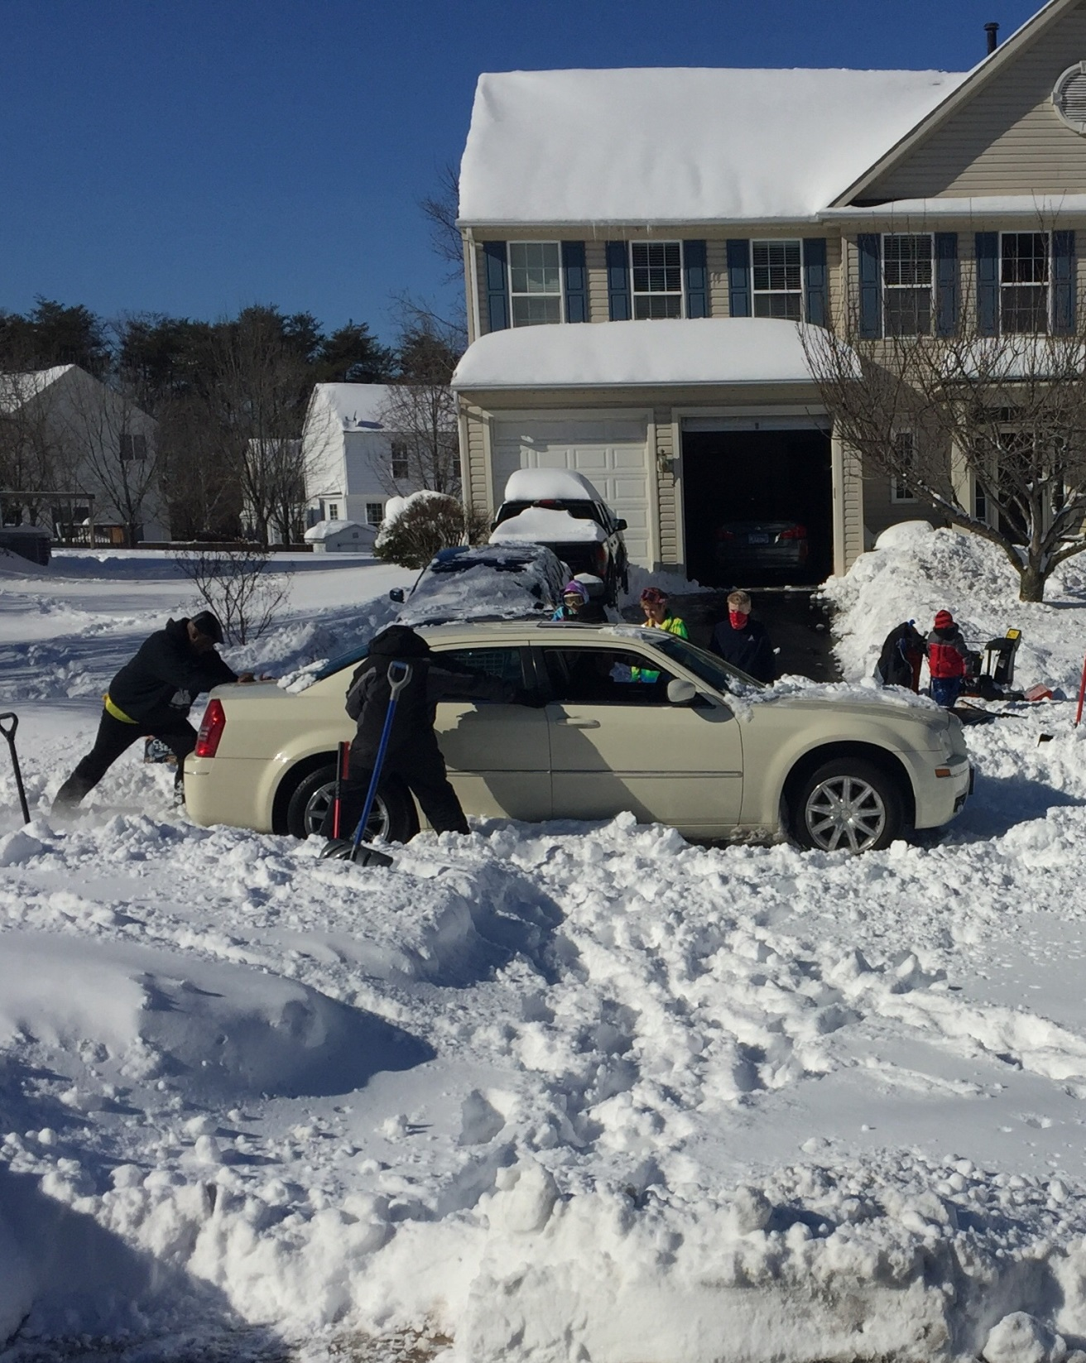
Objectives
In this module, we will cover:
Disaster Recovery features available in Azure
Integrating Azure Disaster Recovery features in a typical infrastructure
Azure Site Recovery in-depth
No sales, just tech !!
Notes:
Title: Objectives
Length: 2 minutes
Participant Notes:
After completing this module, you will be able to:
Disaster Recovery features available in Azure
Integrating Azure Disaster Recovery features in an SAP infrastructure
Azure Site Recovery
Azure Site Recovery for SAP VM infrastructure
Make sure you address what this course will NOT cover based on experience.
Start Time xx:xx / Length: 2 minutes
Review the learning objectives.

Slide 3
What is Disaster Recovery ?

Slide 4


How to stay calm when the lights go out…
Light switch…..
Turn on….
No light…means… Panic…

Slide 5
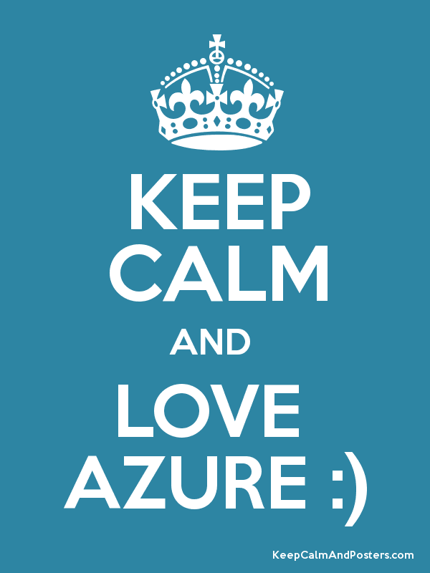

Slide 6
“Familiar” DR Solutions
Storage replication
Stretch cluster using single vLAN with single address space
Active / passive
Dynamic incoming connection failover
Geo-Load Balancing
Stretch cluster
–
Single vLAN
Compute nodes
Compute nodes
Effective, although expensive to deploy and maintain
Normally tied to hardware vendor specific technologies
Difficult to perform partial failovers
SAN replication
Fault tolerant data storage
Fault tolerant data storage
DataCenter 1
DataCenter 2

Slide 7






The D/R challenge
External DR solution
Your on-premises IT platform

Slide 8
Reasons to reconsider your D/R today
Historically challenging
Complicated solutions
Required end-to-end planning and design
Vendor lock-in
In most cases “pretty” expensive
Commodity solutions are now in the market
Public cloud offerings like Azure ☺
OPEX vs. CAPEX for your D/R = it’s way cheaper!!!!

Slide 9
- Monthly scheduled reboots “maintenance plan” - Backup or long term data solution (but having a backup already helps… ☺) - “I can blame it on the IT guy anyway”
Disaster Recovery does not mean…

Slide 10

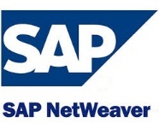

Microsoft’s D/R stack
e.g. SQL Always ON, Exchange DAG,…
SAP 2 or 3-tier Application Servers
SQL
DR Orchestration
with
Azure Site Recovery Manager
VM Replication with Hyper-V Replica
3rd Party Storage Replication
Backups
Compute
Storage
Networks

Slide 11

Microsoft D/R solutions
Integration of WSB/DPM with Microsoft Azure Backup
5
Microsoft Azure
Orchestrated Physical, Hyper-V & VMware VM Replication & Recovery using Azure Site Recovery, between on-premises locations, or between on-premises & Microsoft Azure
}
6
2
Hyper-V Guest Clustering for app- level HA, i.e. SQL Server AlwaysOn FCI
Centralized backup with Data Protection Manager
4
1
Hyper-V Failover Clustering for VM Resilience
Simplified protection with Windows Server Backup
3

Slide 12
Azure Disaster Recovery Components

Slide 13
Azure D/R Components
Traffic Mgr / App Gateway / Load Balancer
Premium Storage for VMs
CDN, Redis DB Cache,…
SQL Geo-Replication
Virtual Machine Availability Sets
Azure Site Recovery (ASR)

Slide 14


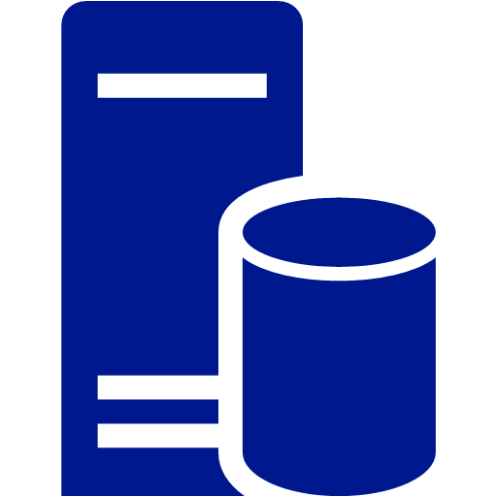

SQL Server Availability Replica on Azure
Azure VNET
WSFC SQL AG Listener
DR SQL DB Sec. Replica
Sync
Commit
Site-to-site or Express Route
SQL DB Prim. Replica WSFC node 1
SQL DB Sec. Replica WSFC node 2
Asynchronous commit
Cluster FSW

Slide 15

Availability Sets
Recommended for workloads with 2+ VM’s
Azure has knowledge of your server topology – won’t shut down all instances during host upgrades.
Provides physical redundancy at the server, power, and network level
Required to achieve 99.95% SLA
Fault Domain
Fault Domain
Server Rack
Server Rack
Availability Set
Availability Set

Slide 16

Azure Site Recovery One solution for multiple infrastructures
Replication
Replication
SAN
SAN
Replication
Microsoft Azure
Hyper-V
Hyper-V
Hyper-V
Hyper-V
Hyper-V
1
Hyper-V to Hyper-V (on-premises)
2
Hyper-V to Hyper-V (on-premises)
3
Hyper-V to Microsoft Azure
Replication
Replication
Microsoft Azure
VMware or Physical
VMware
VMware or Physical
4
VMware or Physical to VMware (on-premises)
5
VMware or Physical to Microsoft Azure

Slide 17
Azure Site Recovery alike tools
Vision Solutions DoubleTake
VMware Site Recovery Manager
Any SAN replication solution (on-premises)
Sungard DR Services
Symantec DR Orchestrator
Veeam Backup and Recovery
…. Many many many more ☺

Slide 18
Why Azure Site Recovery
Core Component of Azure IAAS (Classic and ARM)
Cross platform support (HyperV, SCVMM, VMware, AWS, physical – Windows and Linux OS)
Initially DR solution, but frequently used as migration tool
Think broader with OMS Suite possibilities (Backup, Monitoring, Automation, Auditing,…)

Slide 19
Hyper-V to Azure Site Recovery Configuration – Step by Step

Slide 20
ASR for Hyper-V – Step-by-Step
Configuration Step | Description
1. Configure ASR Vault | Create the ASR Security Vault configuration + download Vault registration Key
2. Prepare on-premises infrastructure | Download and install ASR Provider on Hyper-V/SCVMM/VMware infra
3. Create Azure Storage Account | Create Azure Storage Account for ASR
4. Configure Cloud Protection | Set up protection for the SCVMM/VMware cloud
5. Map Networks | Map on-premises network to Azure VNets
6. Enable Protection for VMs | Create ASR protection group + enable protection for VMs
7. Configure Recovery Plans | Configure Recovery Plans with detailed steps (scripts / automation)
8. Perform Test Failover | Run a test failover to verify Recovery Plans are complete
9. Perform DR simulation | Run through a full DR simulation (planned / unplanned failover)
10. Update DR documentation | Update DR documentation with observations

Slide 21
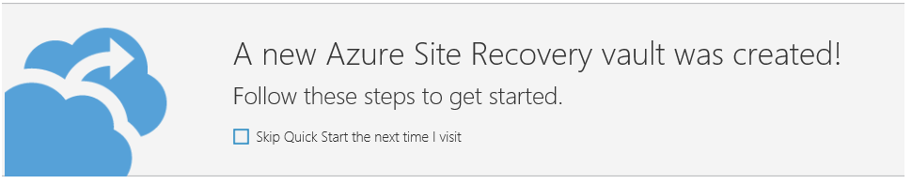
Step 1: Create Recovery Vault
Create Azure Recovery Services Vault
Configure Site Recovery Vault
Configure Management Certificate
Specify Source and Target environments
=> Quick Start Wizard

Slide 22
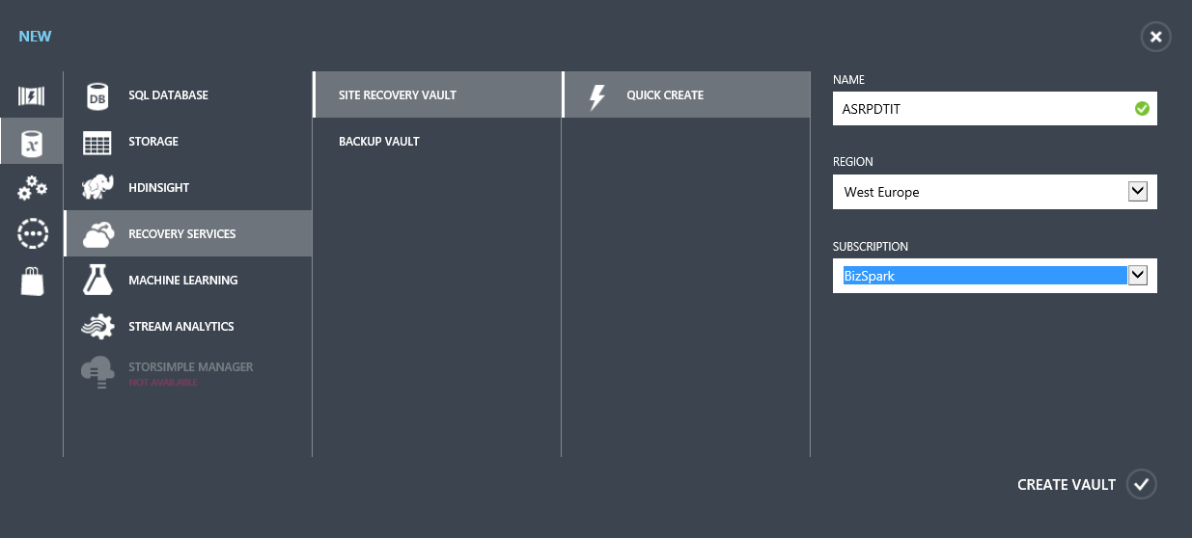
Step 1: Create Recovery Vault

Slide 23
Step 2: Create a Hyper-V Site
Create a Hyper-V Site to group one or more Hyper-V servers belonging to the same physical location (eg. New York Site)
A Hyper-V Server can only belong to 1 Hyper-V Site

Slide 24
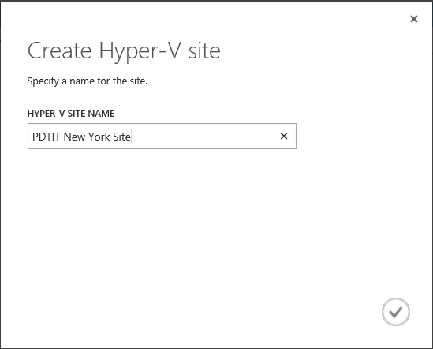
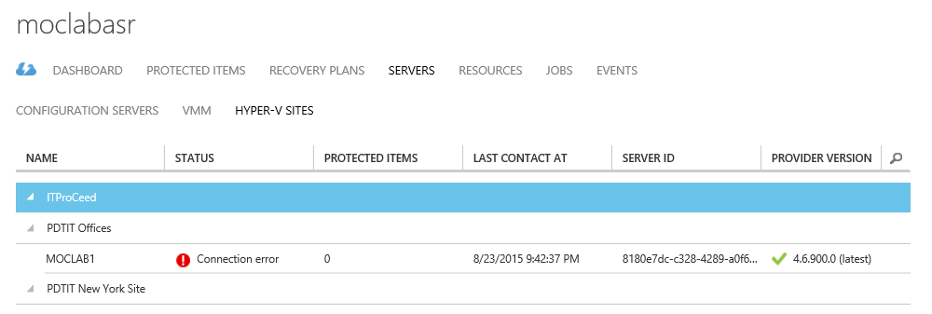
Step 2: Create a Hyper-V Site

Slide 25
Step 3: Prepare Hyper-V Servers
Download & Install a “Registration Key”
Download & Install the Azure Site Recovery Provider
The Registration Key links the Hyper-V Server to the Azure Hyper-V Site
Install both on each server you want to group to the same Hyper-V Site
If Hyper-V cluster nodes, install on all nodes

Slide 26
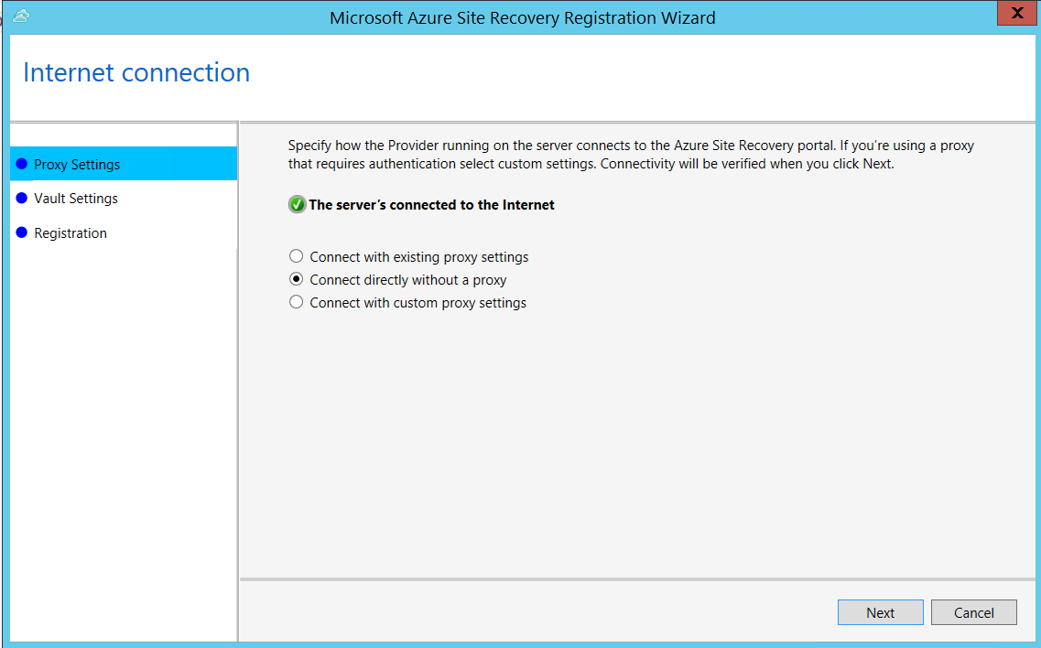
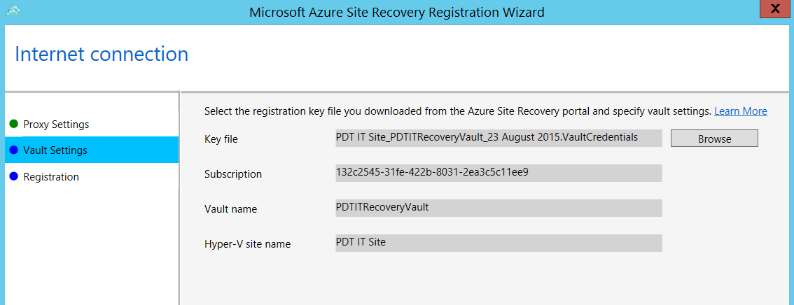
Step 3: Prepare Hyper-V Servers

Slide 27
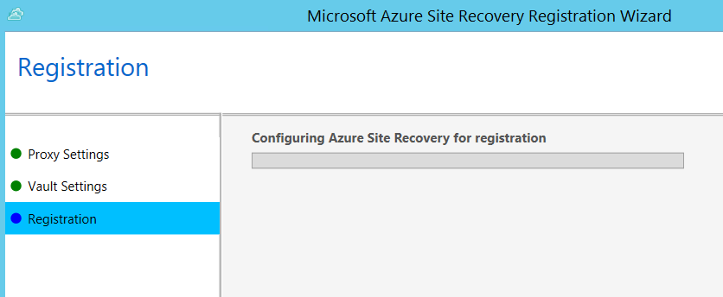
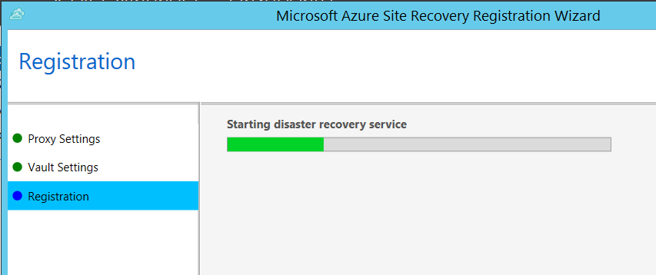
Step 3: Prepare Hyper-V Servers

Slide 28
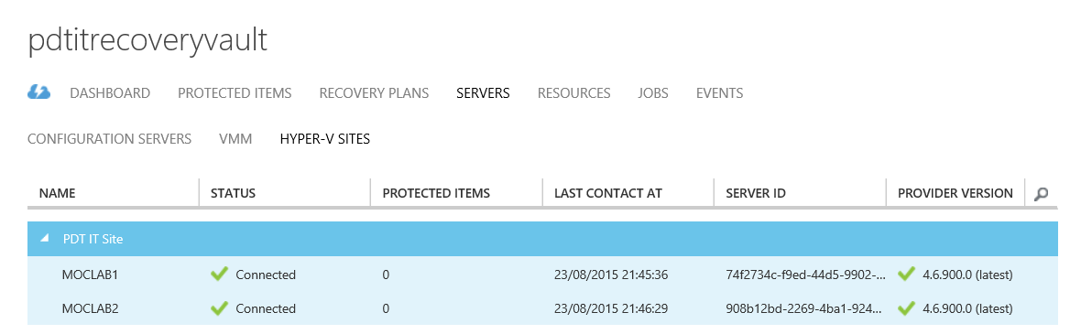
Step 3: Prepare Hyper-V Servers

Slide 29


Step 4: Prepare Resources
Create Storage Account
Unique Name *.core.windows.net
Location / Affinity Group
Geo-Redundant
Create Azure Virtual Network
Unique Name
IP-subnet (class A,B,C) + number of VMs
Location

Slide 30
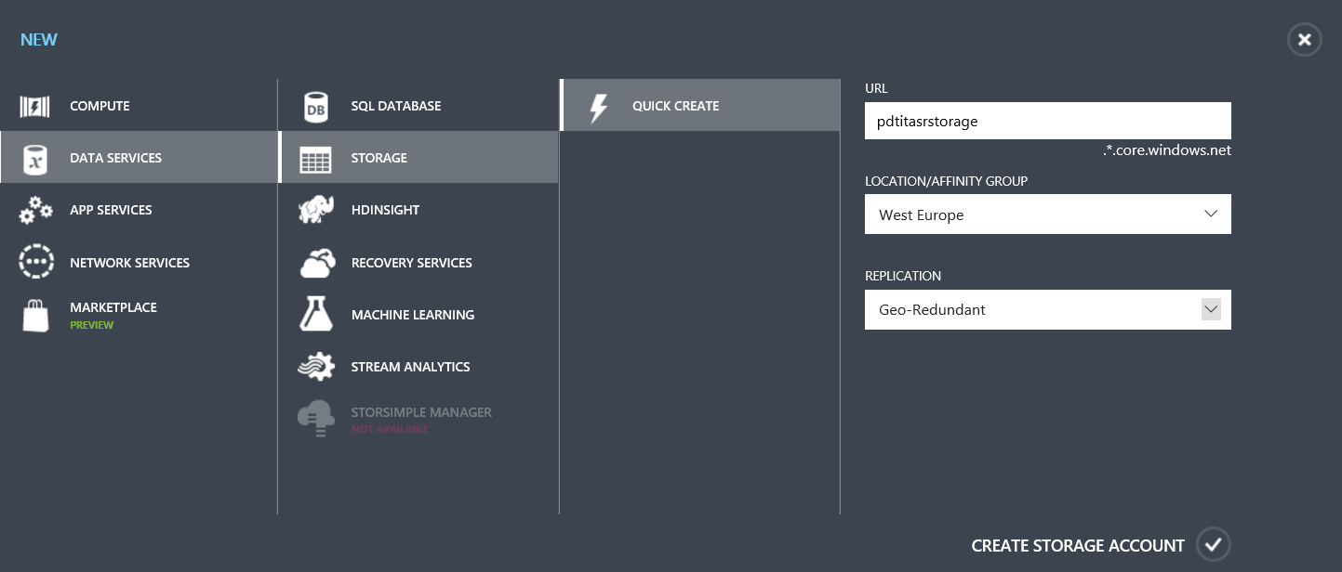
Step 4: Prepare Resources - Storage

Slide 31
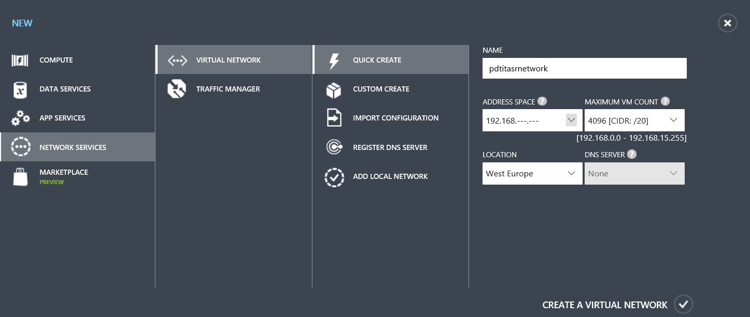
Step 4: Prepare Resources: Network

Slide 32
Step 5: Create and Configure Protection Groups
Protection Groups combine virtual machines that have common protection requirements:
Group Name
Link with previously created Storage Account
Copy Frequency
Recovery Point settings
Frequency of snapshots
Initial replication start time

Slide 33
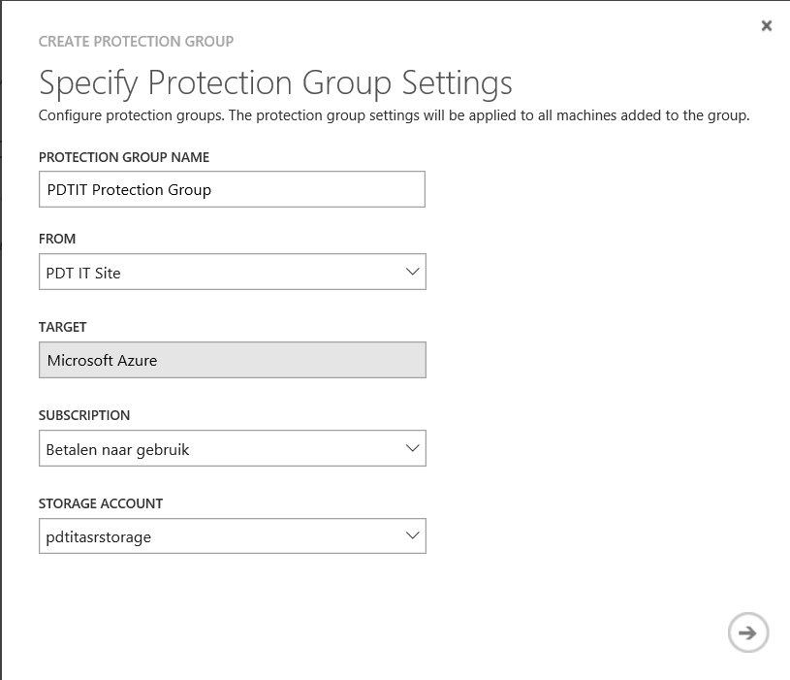
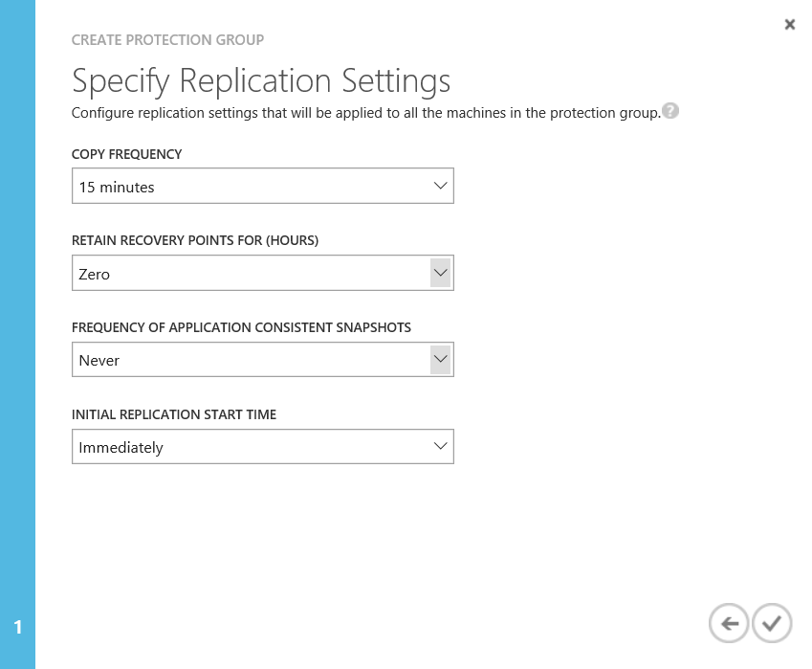
Step 5: Protection Groups

Slide 34
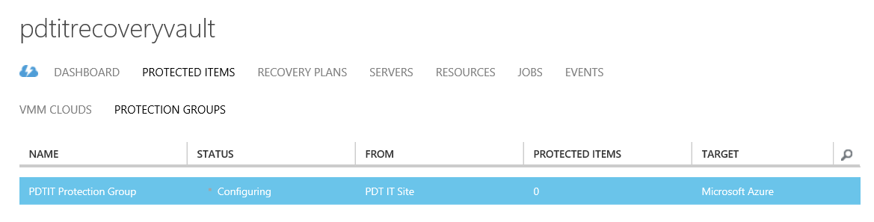
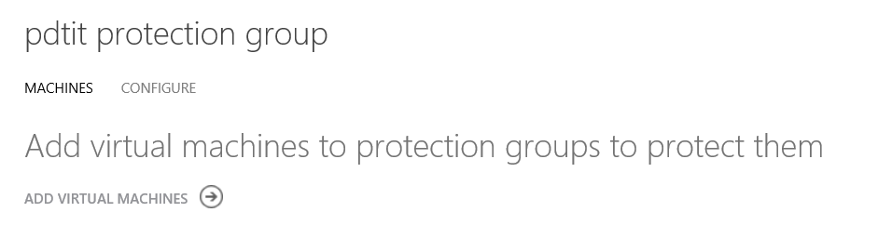
Step 5: Protection Groups

Slide 35
Step 6: Enable protection for VMs
Add Virtual Machines to the configured protection groups
Select Virtual Machine(s)
Specify Operating System
A VM can only be member of 1 protection group
Based on Protection Group Replication Start Time setting, VMs could get replicated immediately, consuming lots of bandwidth, taking time,…

Slide 36
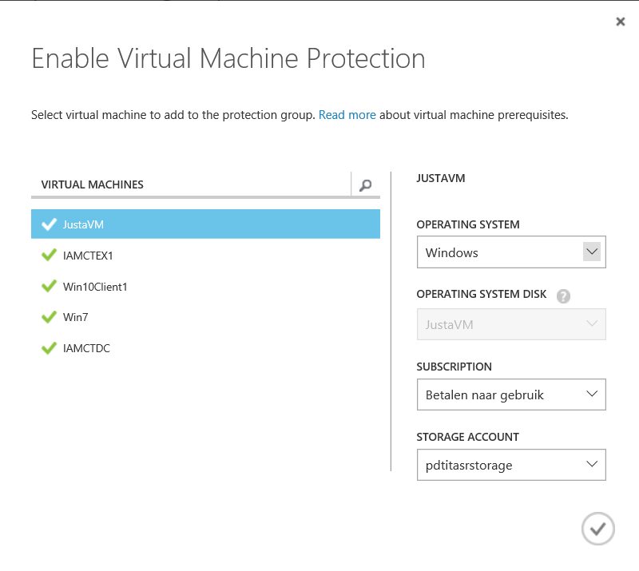
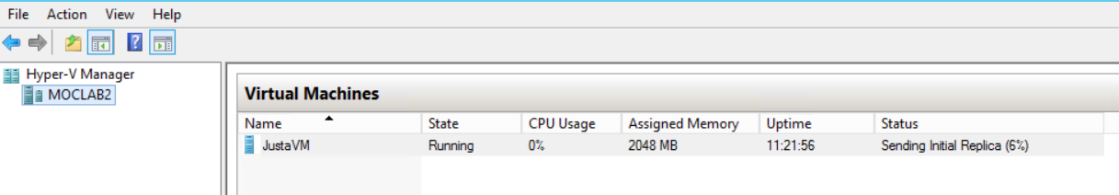
Step 6: Enable protection for VMs

Slide 37
Step 7: Test Deployment
Test Failover without Azure Network
Verifies a VM comes up in Azure, but it won’t be connected to any Azure Network
Test Failover with Azure Network
Verifies the entire replication comes up in Azure, making sure the VMs are connected to their specified Azure recovery network.
Requires configuration of a separate (isolated) Azure network
Verify Test Failover Process from “Jobs” tab

Slide 38
Step 7: Test Deployment Process
The following steps occur during the test process:
Prerequisites check for failover
Create test environment
Create test virtual machine
Preparing the virtual machine
Start the virtual machine
Complete testing
Clean up the test virtual machine
Clean up the test environment
Finalizing test failover
Full test on a typical Windows VM takes only 15min

Slide 39
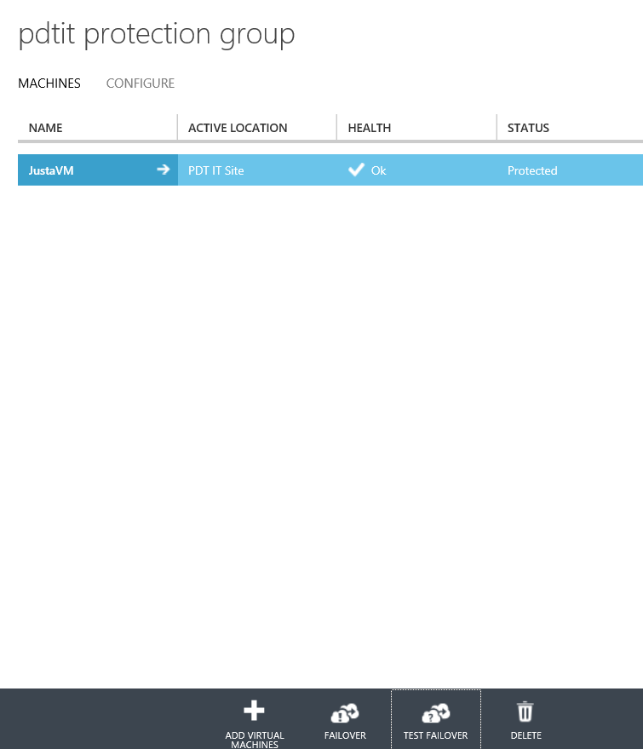
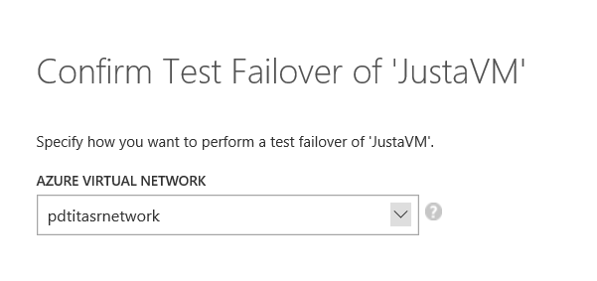
Step 7: Test Failover

Slide 40
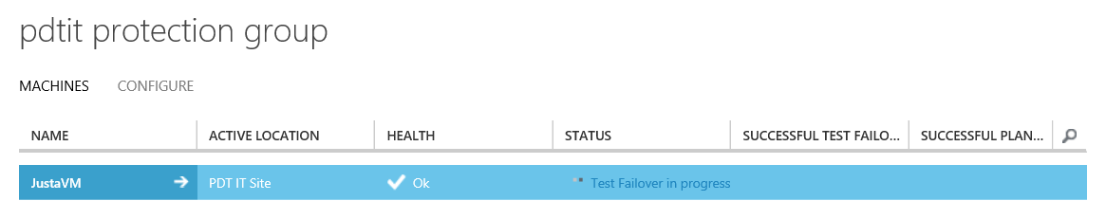
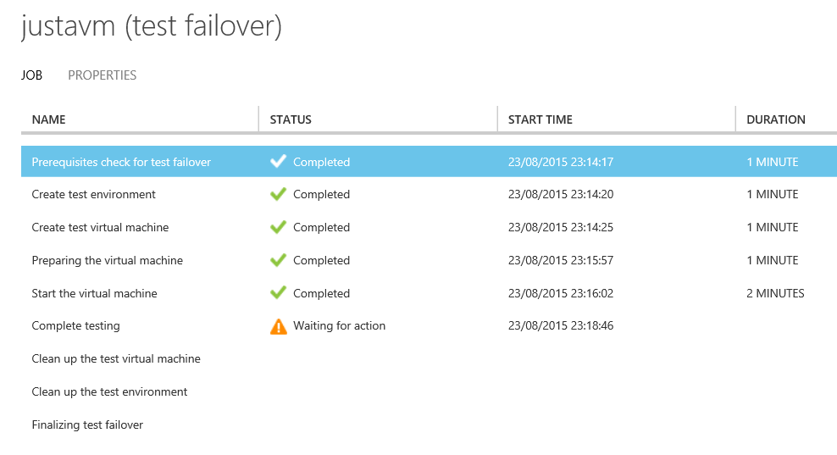
Step 7: Test Failover

Slide 41
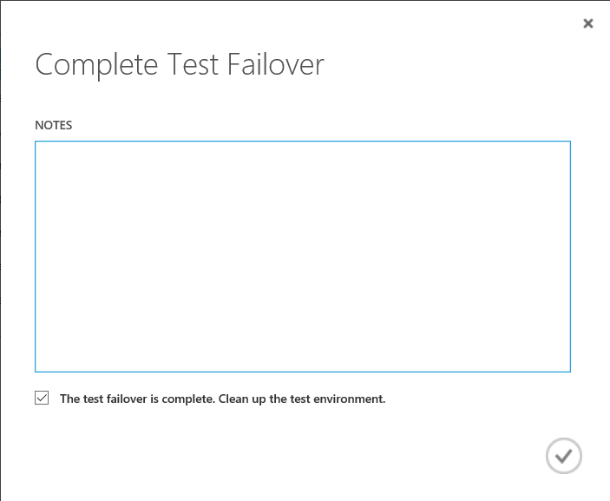
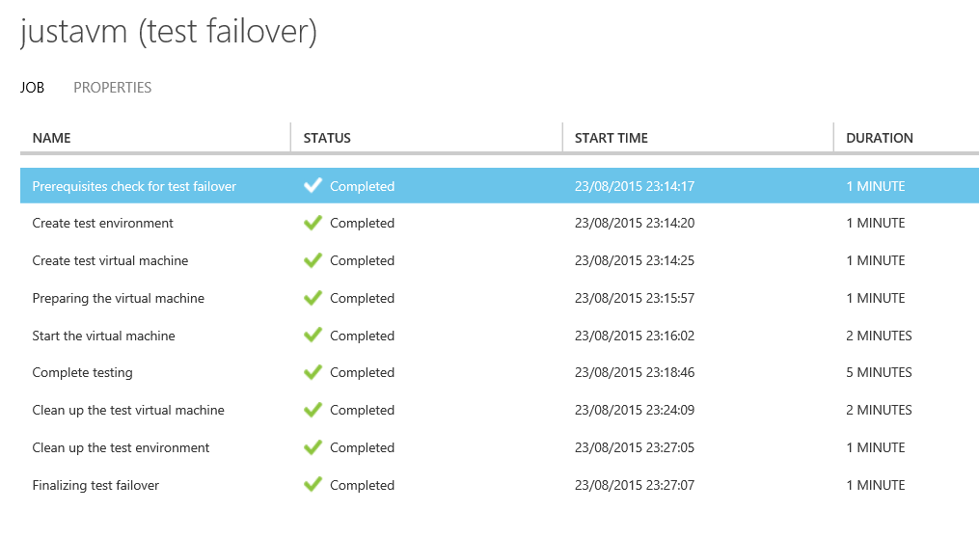
Step 7: Test Failover

Slide 42
That’s all folks ☺
Same process in Azure Resource Manager (see demo)
1st configuration takes about 1 hour (*)
Replication of VMs depends on bandwidth on both ends (bandwidth estimator tool available)
(*)Not including specific recovery plan scripting

Slide 43
Demo
Hyper-V / SCVMM failover configuration walkthrough

Slide 44
VMware / Physical / Amazon AWS Azure Site Recovery Configuration – Step by Step

Slide 45
ASR for VMware / Physical / AWS
Configuration Step | Description
1. Configure ASR Vault | Create the ASR Security Vault configuration + download Vault registration Key
2. Prepare on-premises infrastructure | Download and install ASR Configuration Server and Process Server in VMware infra
3. Create Azure Storage Account | Create Azure Storage Account for ASR
4. Configure Cloud Protection | Add VMware vCenter Servers to Azure ASR
5. Map Networks | Map on-premises network to Azure VNets
6. Enable Protection for VMs | Create ASR protection group + enable protection for VMs
7. Configure Recovery Plans | Configure Recovery Plans with detailed steps (scripts / automation)
8. Perform Test Failover | Run a test failover to verify Recovery Plans are complete
9. Perform DR simulation | Run through a full DR simulation (planned / unplanned failover)
10. Update DR documentation | Update DR documentation with observations

Slide 46
Step 1: Create Recovery Vault
Create Azure Recovery Services Vault
Configure Site Recovery Vault
Configure Management Certificate
Specify Source and Target environments
=> Quick Start Wizard

Slide 47
Step 2 : Set Up the Configuration Server
This server will store all ASR configuration settings
Server must be set up on-premises
Requires the following parameters:
Unique Virtual Machine name
Admin credentials for this server
How the connection between Azure and the source environment will occur (public internet or through VPN/ExpressRoute)
Azure network and IP Address information

Slide 48
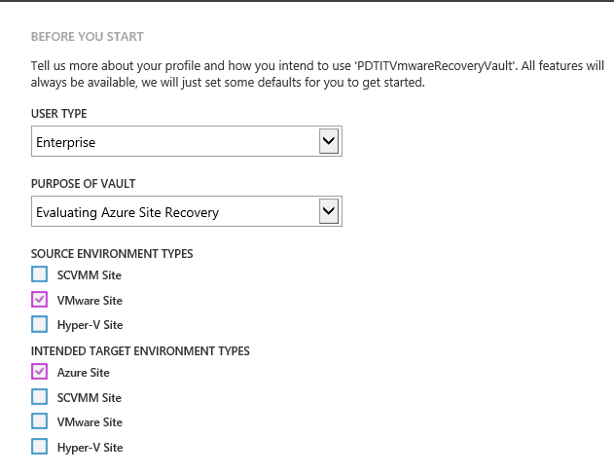
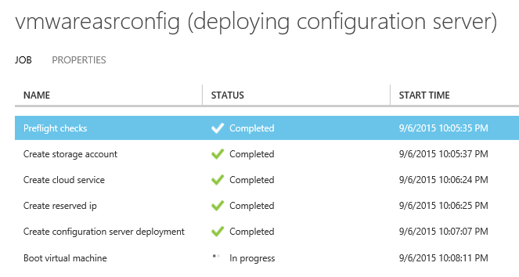
Step 2 : Set Up the Configuration Server

Slide 49
Step 2: Set Up the Configuration Server
Once the Configuration Server is available, log on to it and register it in the ASR Vault:
Download the Registration Key
Run the Azure Site Recovery Configuration Server installation (starts automatically upon login on to the server)
Configure Management Accounts to connect to the physical servers or VMware infrastructure

Slide 50
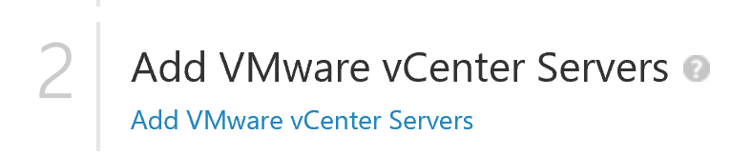
Step 3: Add VMware vCenter servers
Detects the on-premises Configuration Server
Registers the Configuration Server in the Azure Site Recovery Vault (select physical source instead of VMware vCenter if using physical or AWS machines)

Slide 51
Step 4: Prepare Resources - Storage

Slide 52
Step 4: Prepare Resources: Network

Slide 53
Step 5: Create and Configure Protection Groups
Protection Groups combine virtual machines that have common protection requirements:
Group Name
Link with previously created Storage Account
Copy Frequency
Recovery Point settings
Frequency of snapshots
Initial replication start time

Slide 54
Step 5: Protection Groups

Slide 55
Step 5: Protection Groups

Slide 56
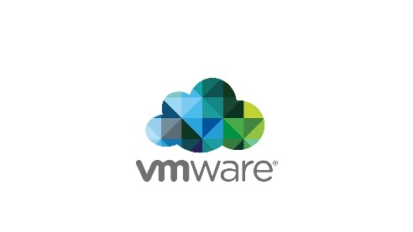
Step 6: Enable protection for VMs
Add Virtual Machines to the configured protection groups
Select Virtual Machine(s)
Specify Operating System
A VM can only be member of 1 protection group
Based on Protection Group Replication Start Time setting, VMs could get replicated immediately, consuming lots of bandwidth, taking time,…

Slide 57
Step 6: Enable protection for VMs

Slide 58
Step 7: Test Deployment
Test Failover without Azure Network
Verifies a VM comes up in Azure, but it won’t be connected to any Azure Network
Test Failover with Azure Network
Verifies the entire replication comes up in Azure, making sure the VMs are connected to their specified Azure recovery network.
Requires configuration of a separate (isolated) Azure network
Verify Test Failover Process from “Jobs” tab

Slide 59
Step 7: Test Deployment Process
The following steps occur during the test process:
Prerequisites check for failover
Create test environment
Create test virtual machine
Preparing the virtual machine
Start the virtual machine
Complete testing
Clean up the test virtual machine
Clean up the test environment
Finalizing test failover
Full test on a typical Windows VM takes only 15min

Slide 60
Step 7: Test Failover

Slide 61
Step 7: Test Failover

Slide 62
Step 7: Test Failover
Notes:
Once you confirm the failover action from the previous step, the remaining test failover steps are executed, and if all is Ok, all steps report as “completed”

Slide 63
That’s all folks ☺
Same process in Azure Resource Manager (see demo)
1st configuration takes about 1,5 hours (*)
Replication of VMs depends on bandwidth on both ends (bandwidth estimator tool available)
(*)Not including specific recovery plan scripting

Slide 64
Demo
Azure Site Recovery for ASR VM workloads
Step-by-Step walkthrough

Slide 65
Recovery Plans explained
Customized scripts to execute “finetuned steps”
Gallery or in-house developed
PowerShell or other engine
Grouped / Shutdown / Startup structure

Slide 66
Demo
Recovery Plan
Step-by-Step walkthrough

Slide 67
Objectives
In this module, we will cover:
Disaster Recovery features available in Azure
Integrating Azure Disaster Recovery features in a typical infrastructure
Azure Site Recovery in-depth
No sales, just tech !!
Notes:
Title: Objectives
Length: 2 minutes
Participant Notes:
After completing this module, you will be able to:
Disaster Recovery features available in Azure
Integrating Azure Disaster Recovery features in an SAP infrastructure
Azure Site Recovery
Azure Site Recovery for SAP VM infrastructure
Make sure you address what this course will NOT cover based on experience.
Start Time xx:xx / Length: 2 minutes
Review the learning objectives.

Slide 68
Questions?
pedete@Microsoft.com
@pdtit
Notes:
Title: Questions?
Length: 5 minutes
Start Time xx:xx / Length: 5 minutes
Invite participants to ask final questions about the content or anything else they are concerned about.
“Before we discuss the homework assignment and conclude this session, does anyone have any final questions for me? If so, type your name or your question on the screen.”
Follow up with anyone who poses a question.

